Slide 1
Model Free Control

Slide 2
Outline
Recap on Model Free Prediction
On-Policy learning
Off-Policy learning

Slide 3
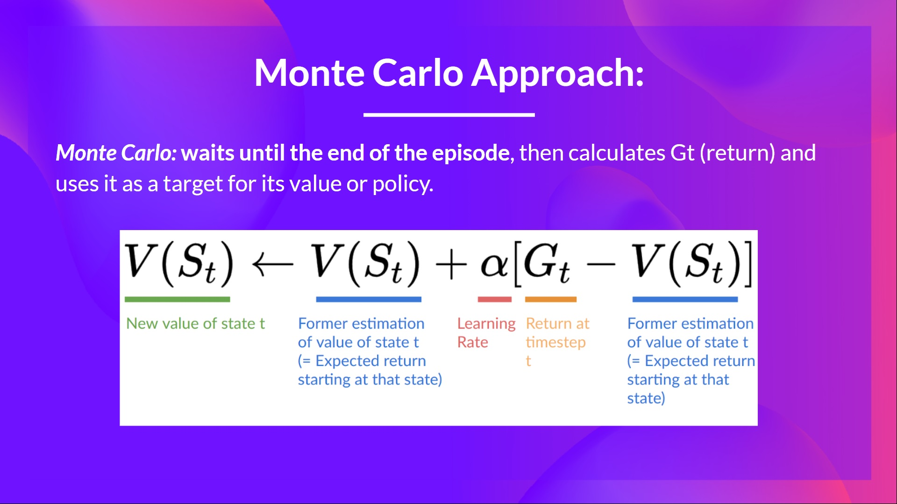

Slide 4
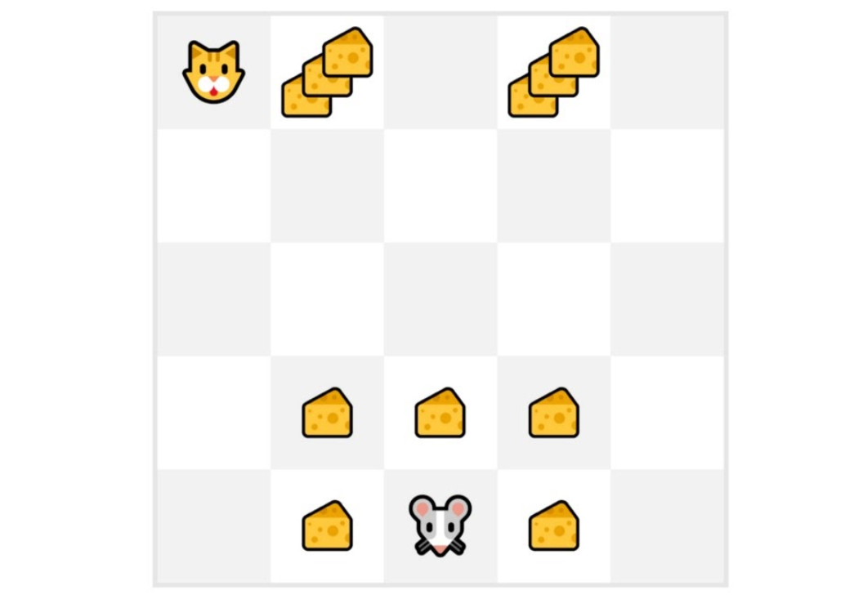
Monte-Carlo Reinforcement Learning
For each episode, we always start at the same starting point.
The agent takes actions using a random policy.
We terminate the episode if the cat eats the mouse or if the mouse moves more than 10 steps.

Slide 5
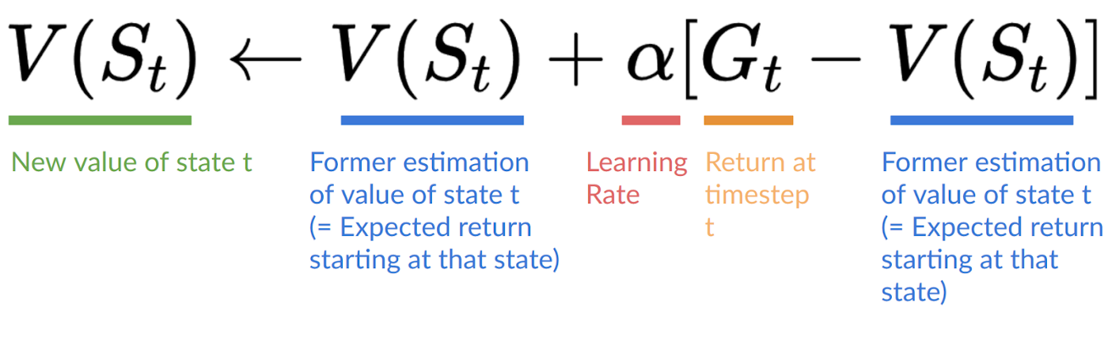
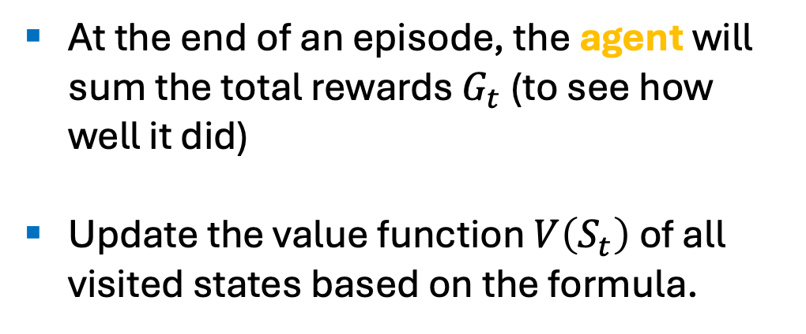
Monte-Carlo Reinforcement Learning
At the end of an episode, the agent will sum the total rewards $G_{t}$ (to see how well it did)
Update the value function $V\left(S_{t}\right)$ of all visited states based on the formula.

Slide 6
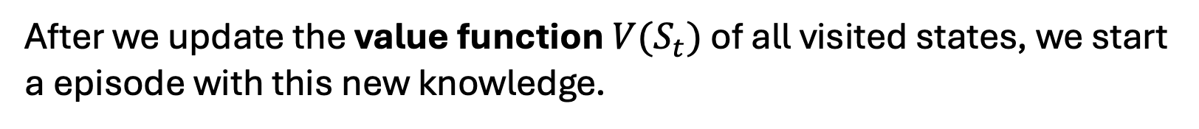
Monte-Carlo Reinforcement Learning
After we update the value function $V(S_{t})$ of all visited states, we start a episode with this new knowledge.

Slide 7
Monte-Carlo Reinforcement Learning
By running more and more episodes, the agent will learn to play better and better.

Slide 8
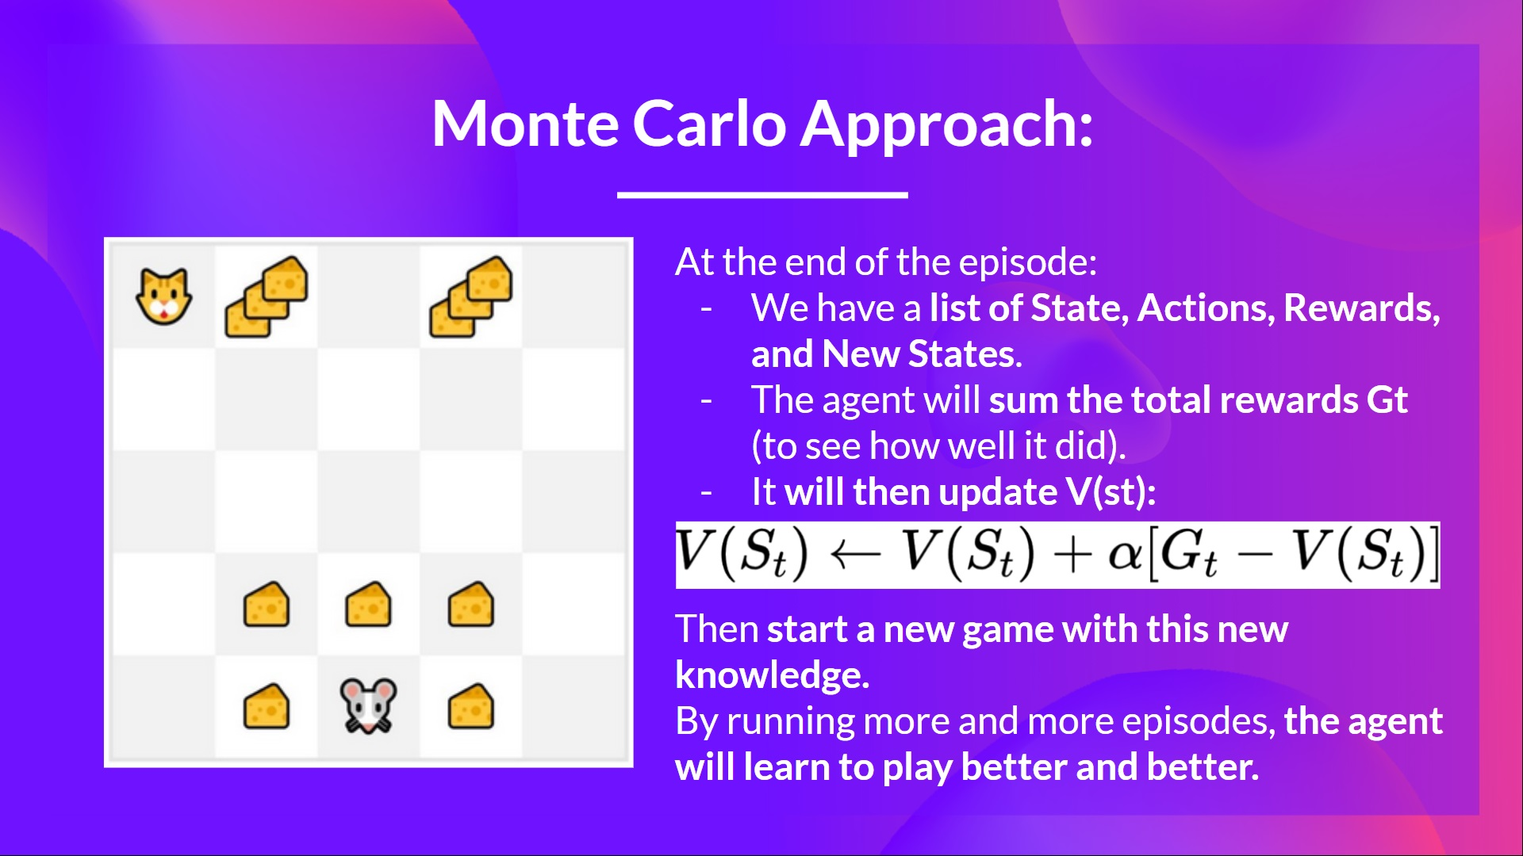

Slide 9
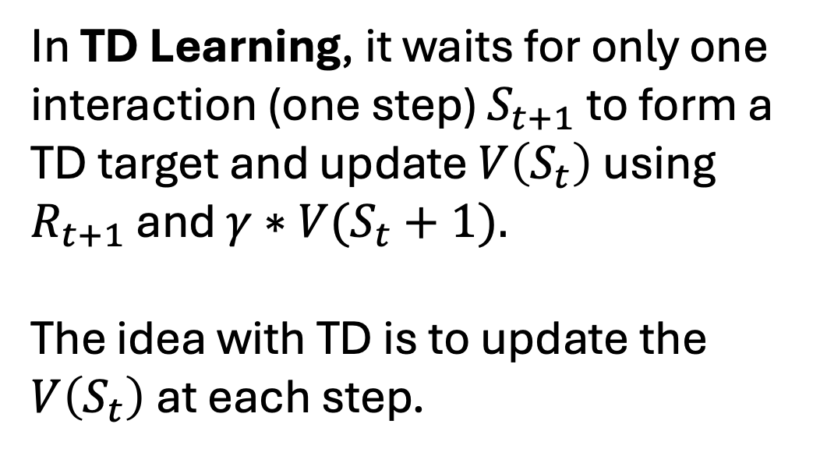
Temporal Difference Reinforcement Learning
In TD Learning, it waits for only one interaction (one step) $S_{t+1}$to form a TD target and update $V\left(S_{t}\right)$ using $R_{t+1}$ and $γ∗V(S_{t}+1).$
The idea with TD is to update the $V\left(S_{t}\right)$at each step.

Slide 10
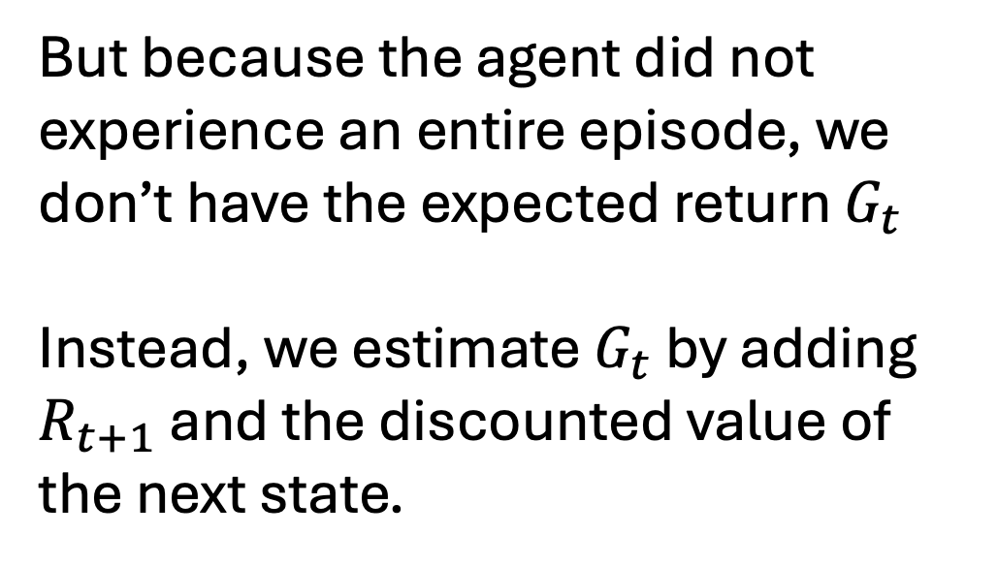
Temporal Difference Reinforcement Learning
But because the agent did not experience an entire episode, we don’t have​ the expected return $G_{t}$
Instead, we estimate $G_{t}$​ by adding $R_{t+1}$ and the discounted value of the next state.

Slide 11
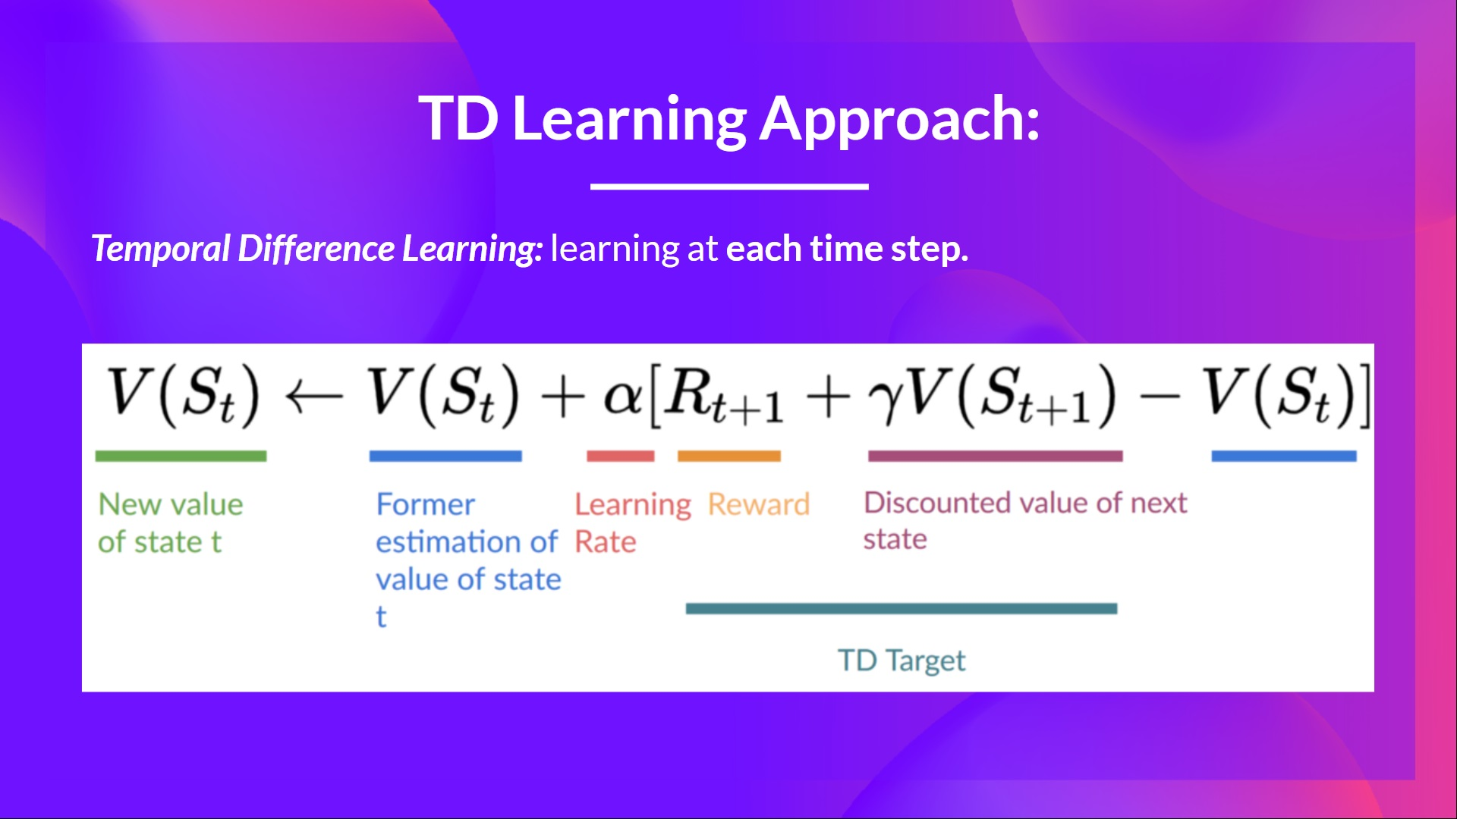

Slide 12
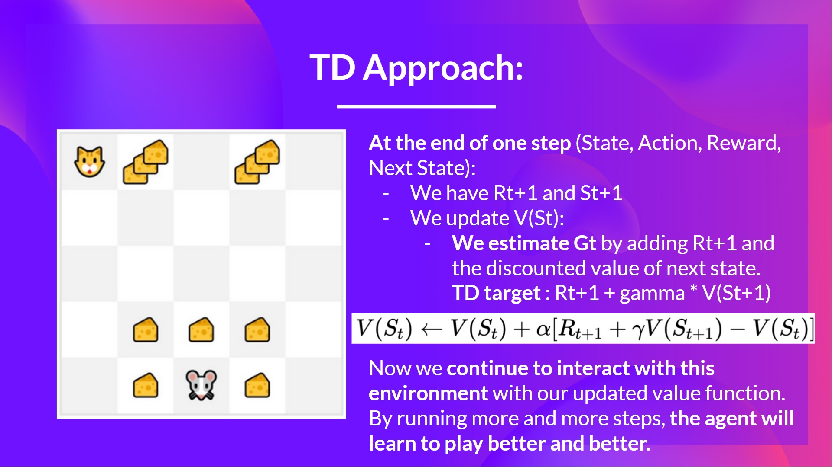

Slide 13
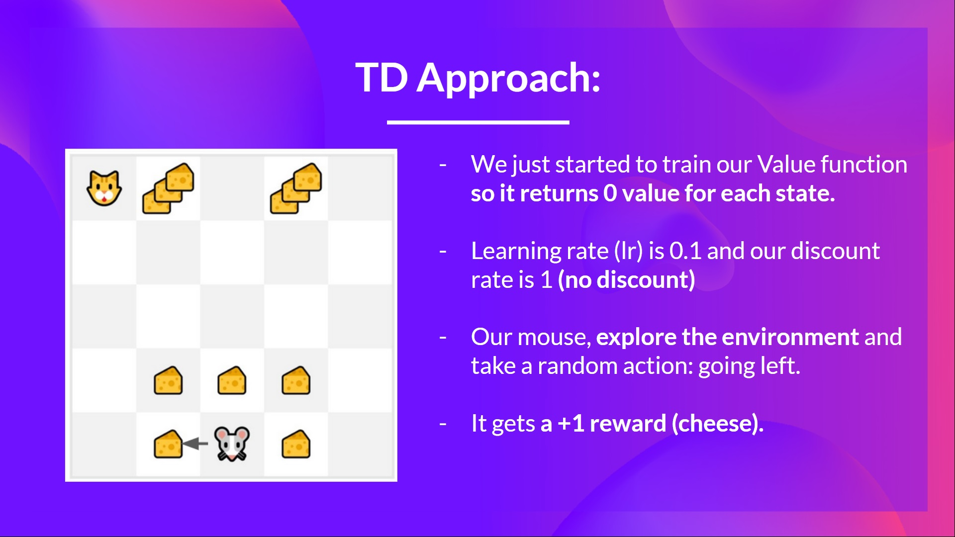

Slide 14
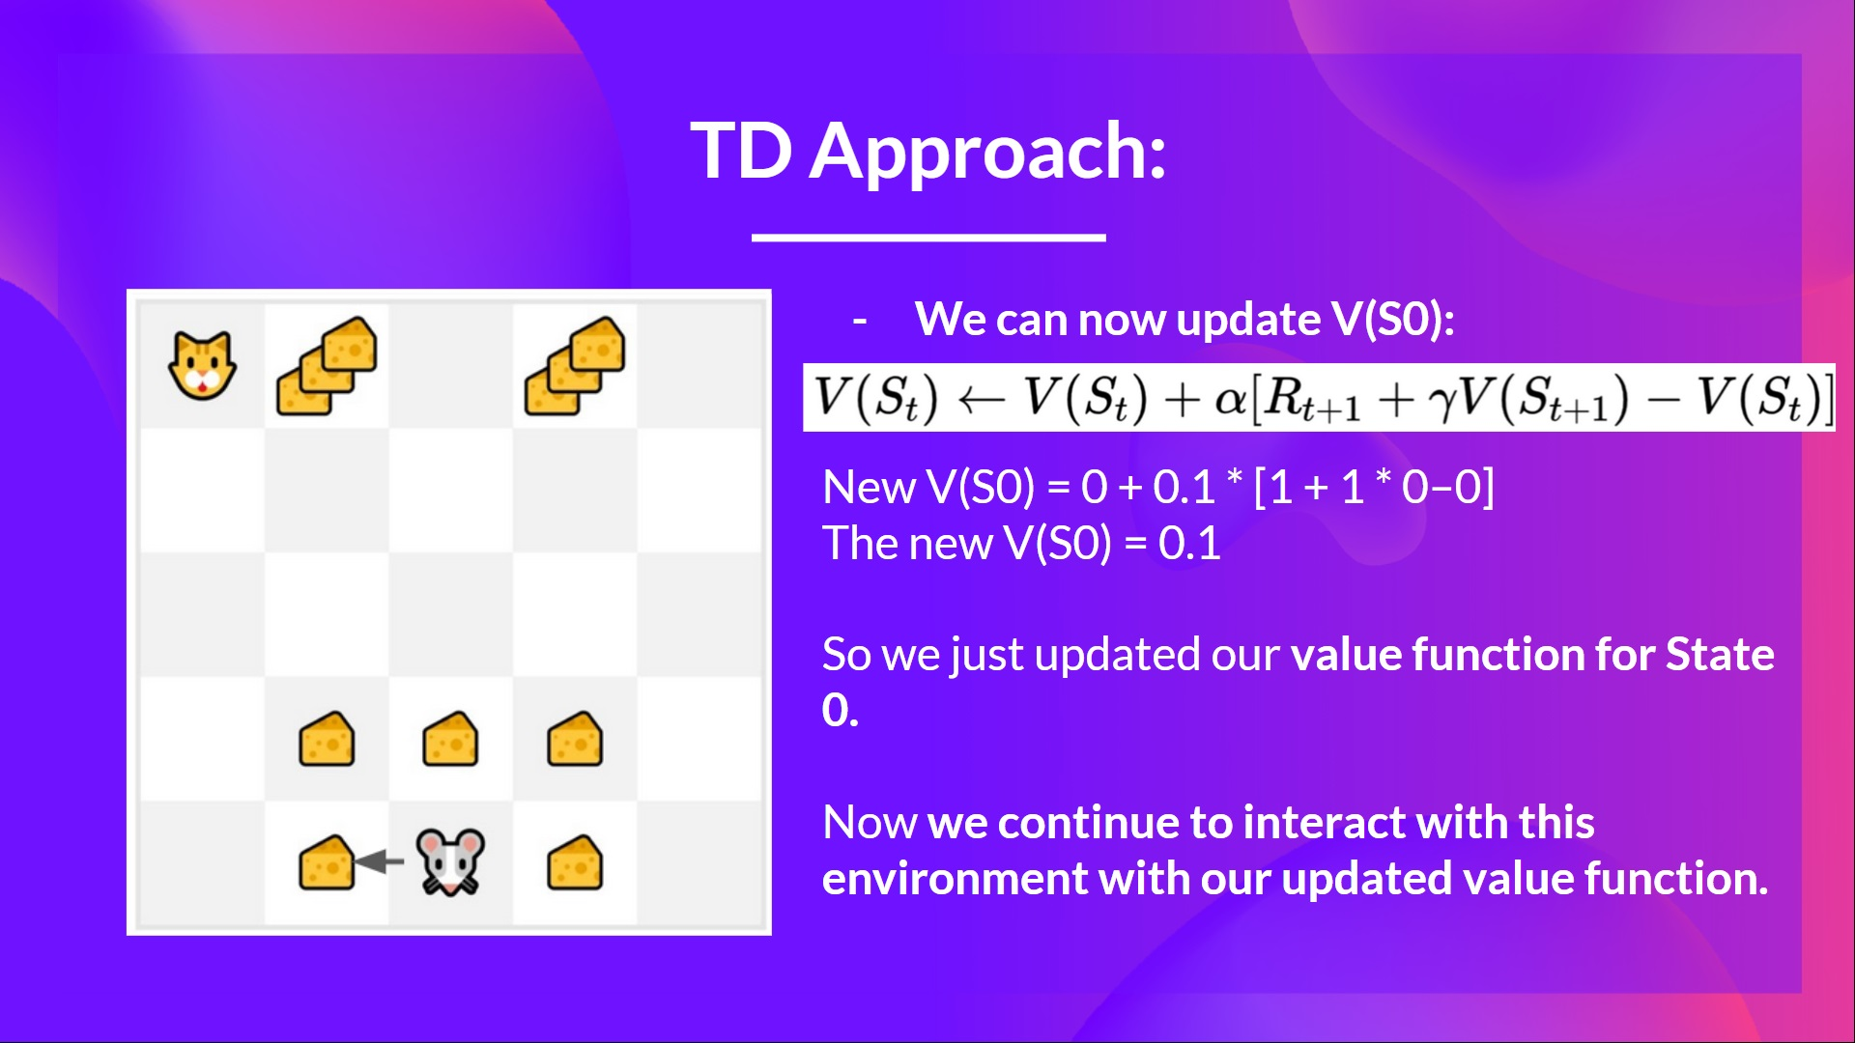

Slide 15
Outline
Recap on Model Free Prediction
On-Policy learning
Off-Policy learning

Slide 16
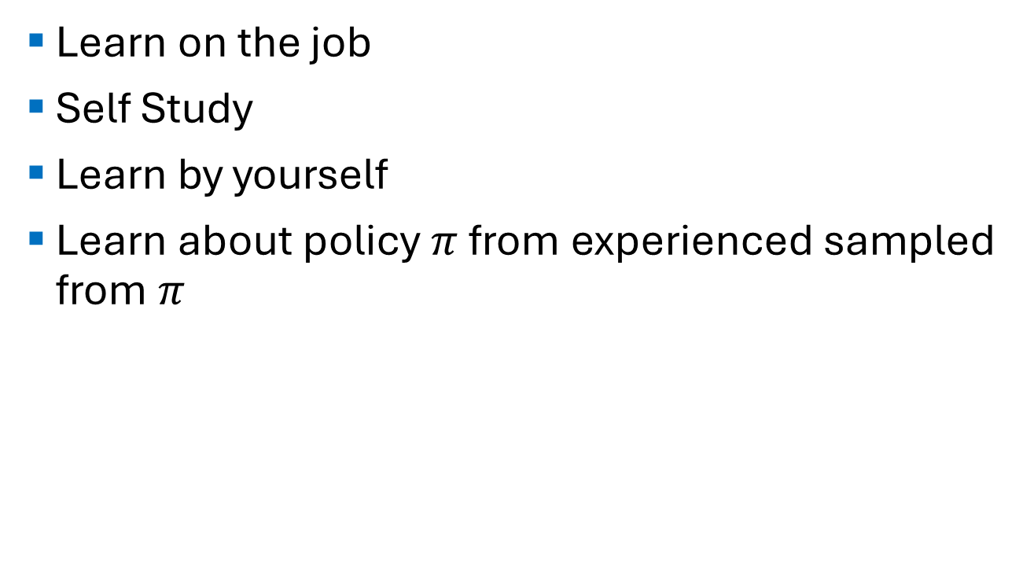
On-Policy Learning
Learn on the job
Self Study
Learn by yourself
Learn about policy $π$ from experienced sampled from $π$

Slide 17
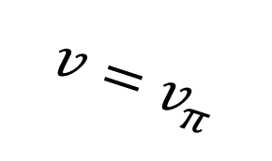
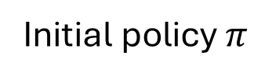
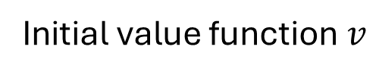
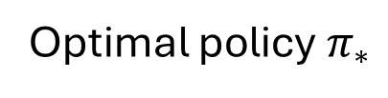
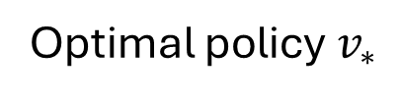
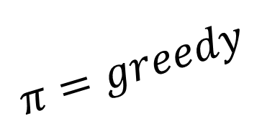
Recap: Generalised Policy Iteration
$$v=v_{π}$$
Initial value function $v$
Optimal policy $v_{∗}$
Initial policy $π$
Optimal policy $π_{∗}$
$$π=greedy$$

Slide 18
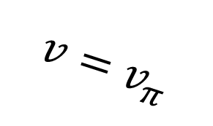
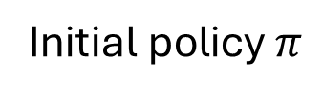
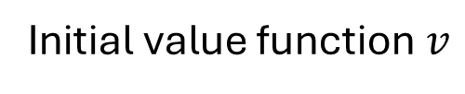
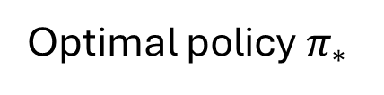
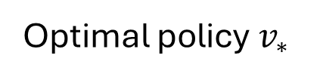
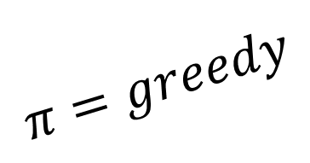
$$v=v_{π}$$
Initial value function $v$
Optimal policy $v_{∗}$
Initial policy $π$
Optimal policy $π_{∗}$
$$π=greedy$$
Remember when we used dynamic programming, we repeated the process of evaluating and updating until we converge to the optimal policy

Slide 19
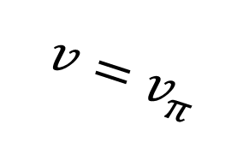
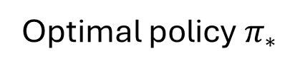
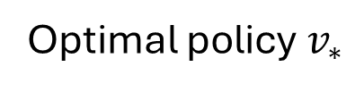
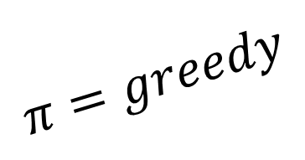
$$v=v_{π}$$
Initial value function $v$
Optimal policy $v_{∗}$
Initial policy $π$
Optimal policy $π_{∗}$
$$π=greedy$$
For Policy evaluation, we used Iterative policy evaluation
For Policy improvement, we used Greedy policy improvement

Slide 20
$$v=v_{π}$$
Initial value function $v$
Optimal policy $v_{∗}$
Initial policy $π$
Optimal policy $π_{∗}$
$$π=greedy$$
Using this method, we found the optimal policy because the MDP is known. But what about model free environments?

Slide 21
Generalised Policy Iteration with Monte-Carlo Evaluation
$$v=v_{π}$$
Initial value function $v$
Optimal policy $v_{∗}$
Initial policy $π$
Optimal policy $π_{∗}$
$$π=greedy$$

Slide 22
$$v=v_{π}$$
Initial value function $v$
Optimal policy $v_{∗}$
Initial policy $π$
Optimal policy $π_{∗}$
$$π=greedy$$
For Policy evaluation, can we use Monte-Carlo policy evaluation?
For Policy improvement, can we use Greedy policy improvement?

Slide 23
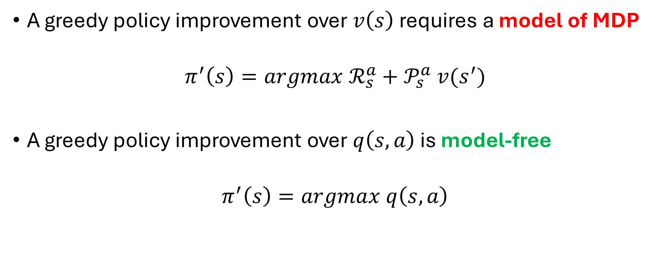
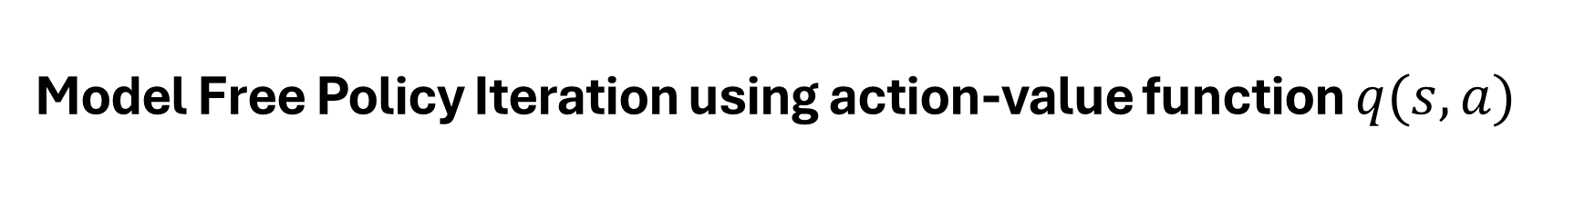
Model Free Policy Iteration using action-value function $q(s,a)$
A greedy policy improvement over $v\left(s\right)$ requires a model of MDP
$$π^{′}\left(s\right)=argmax ℛ_{s}^{a}+𝒫_{s}^{a} v(s^{′})$$
A greedy policy improvement over $q\left(s,a\right)$ is model-free
$$π^{′}\left(s\right)=argmax q\left(s,a\right)$$

Slide 24
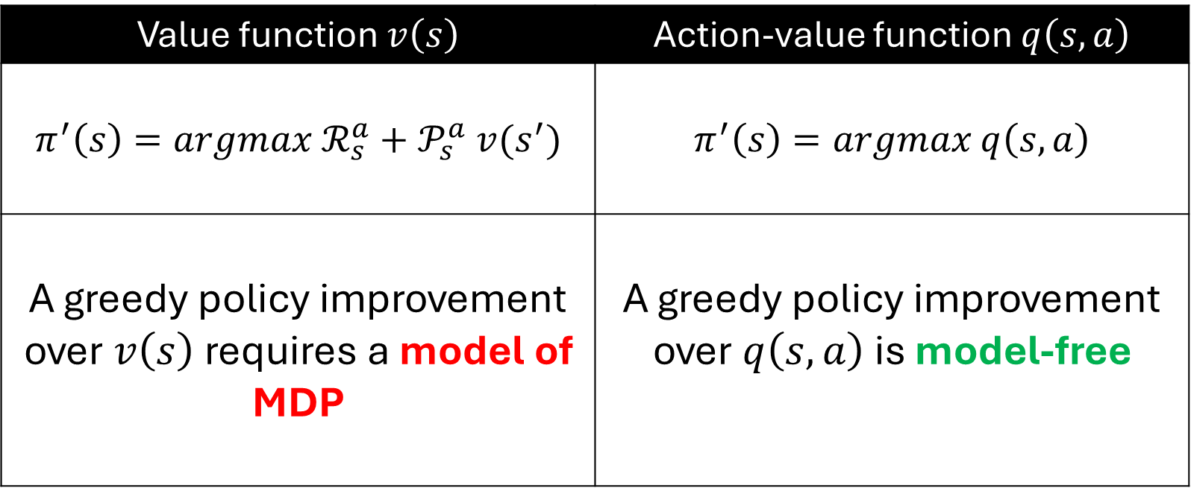
Model Free Policy Iteration using action-value function $q(s,a)$
Value function $v\left(s\right)$ | Action-value function $q\left(s,a\right)$
$$π^{′}\left(s\right)=argmax ℛ_{s}^{a}+𝒫_{s}^{a} v(s^{′})$$ | $$π^{′}\left(s\right)=argmax q\left(s,a\right)$$
A greedy policy improvement over $v\left(s\right)$ requires a model of MDP | A greedy policy improvement over $q\left(s,a\right)$ is model-free

Slide 25
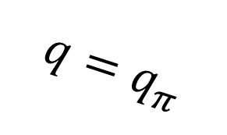
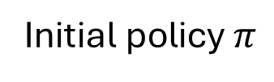
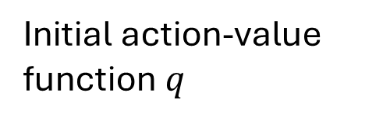
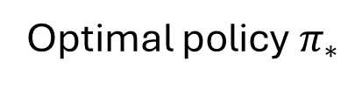
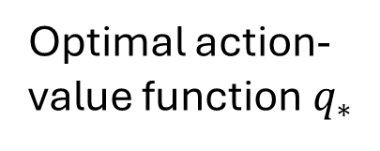
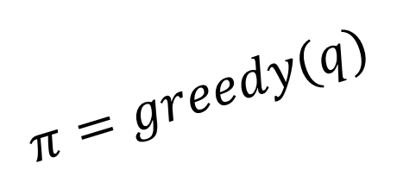
$$q=q_{π}$$
Initial action-value function $q$
Optimal action-value function $q_{∗}$
Initial policy $π$
Optimal policy $π_{∗}$
$$π=greedy(q)$$
For Policy evaluation, can we use Monte-Carlo policy evaluation?
For Policy improvement, can we use Greedy policy improvement?

Slide 26
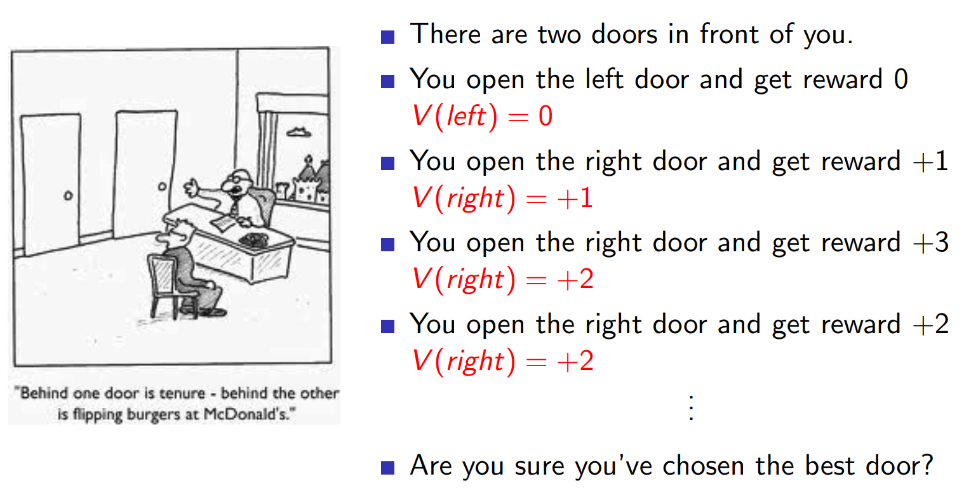
Example of Greedy Action Selection

Slide 27
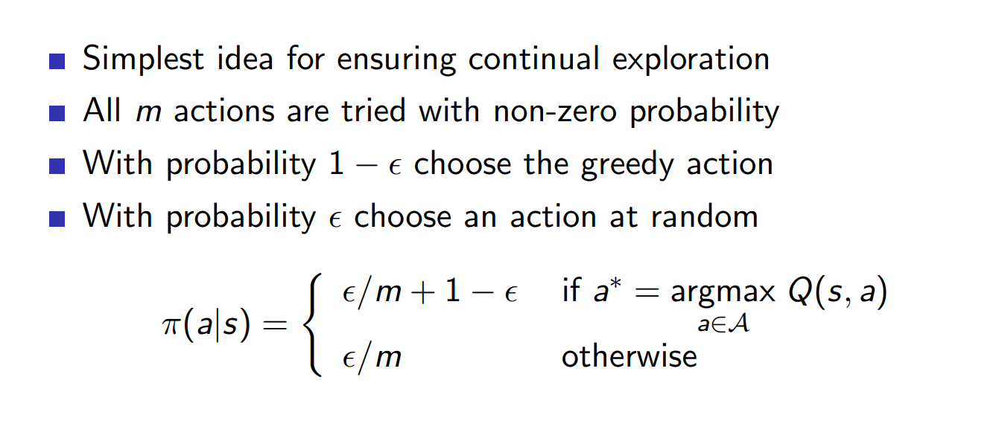
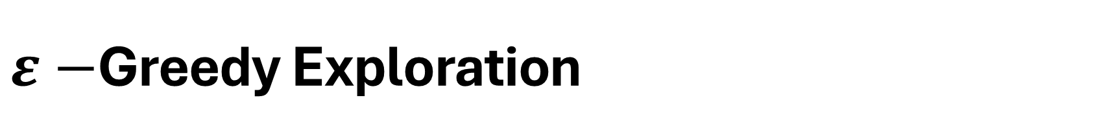
$ε−$Greedy Exploration

Slide 28
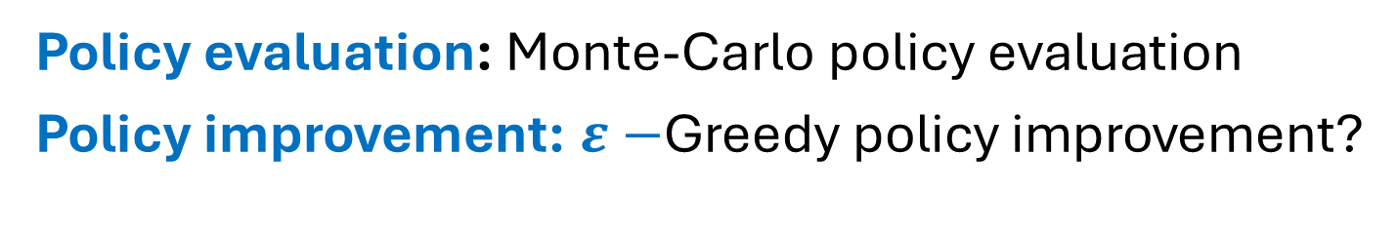
$$q=q_{π}$$
Initial action-value function $q$
Optimal action-value function $q_{∗}$
Initial policy $π$
Optimal policy $π_{∗}$
$$π=greedy(q)$$
Policy evaluation: Monte-Carlo policy evaluation
Policy improvement: $ε−$Greedy policy improvement?

Slide 29
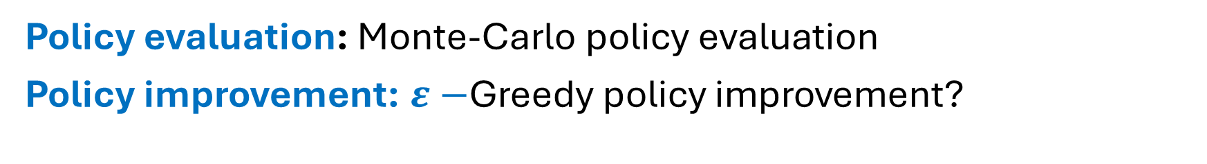
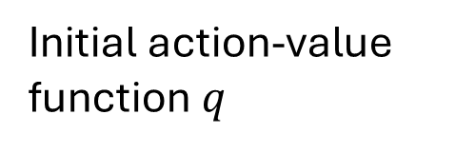
$$q=q_{π}$$
Optimal action-value function $q_{∗}$
Initial action-value function $q$
Optimal policy $π_{∗}$
$$π=greedy(q)$$
Policy evaluation: Monte-Carlo policy evaluation
Policy improvement: $ε−$Greedy policy improvement?

Slide 30
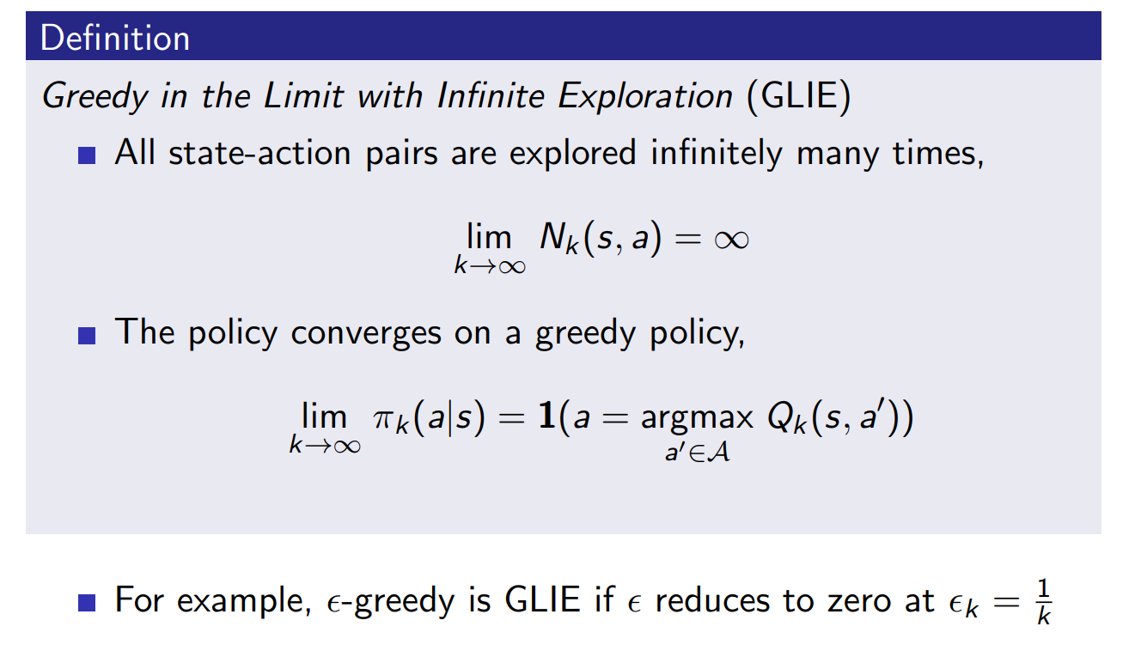
GLIE Monte-Carlo Control

Slide 31
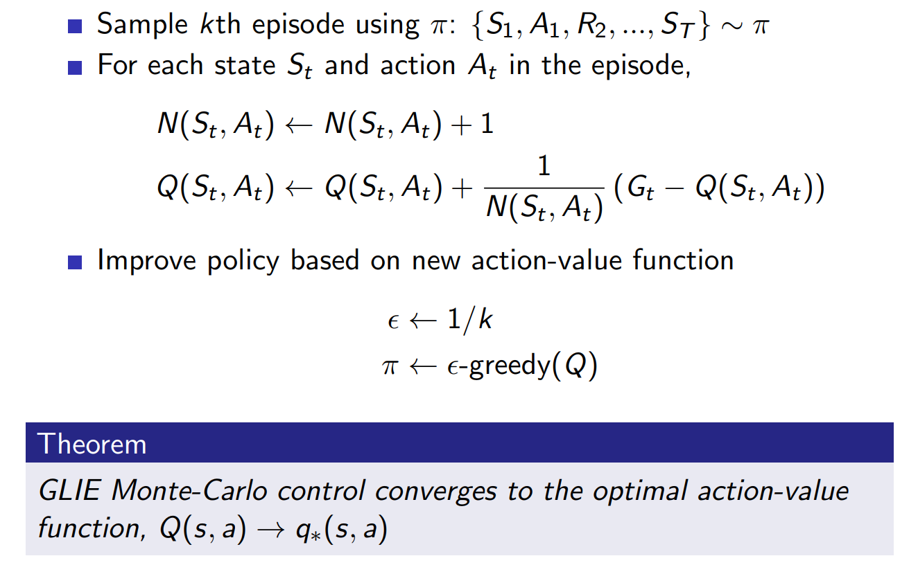
GLIE Monte-Carlo Control

Slide 32
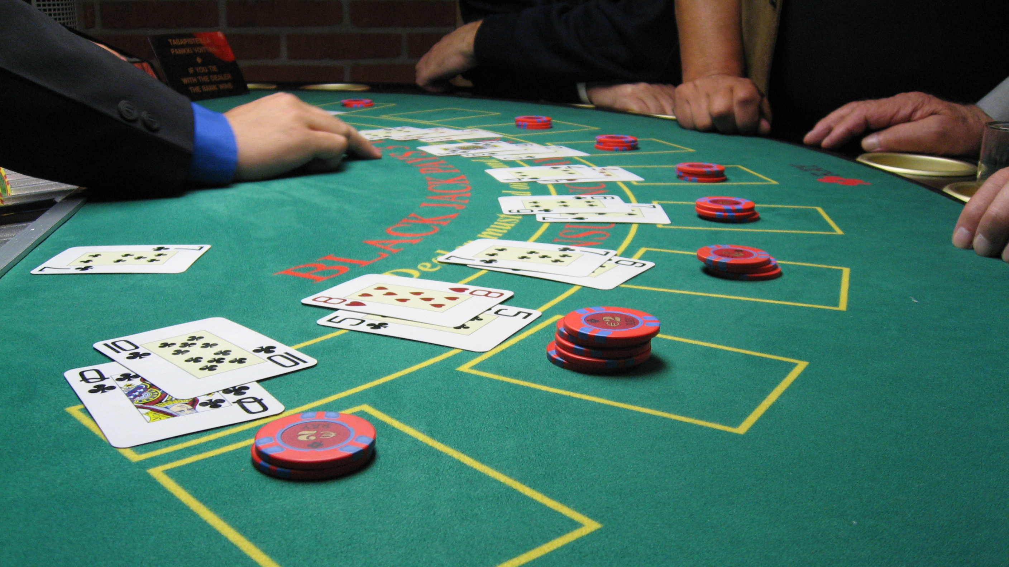
Monte-Carlo Control in Blackjack

Slide 33
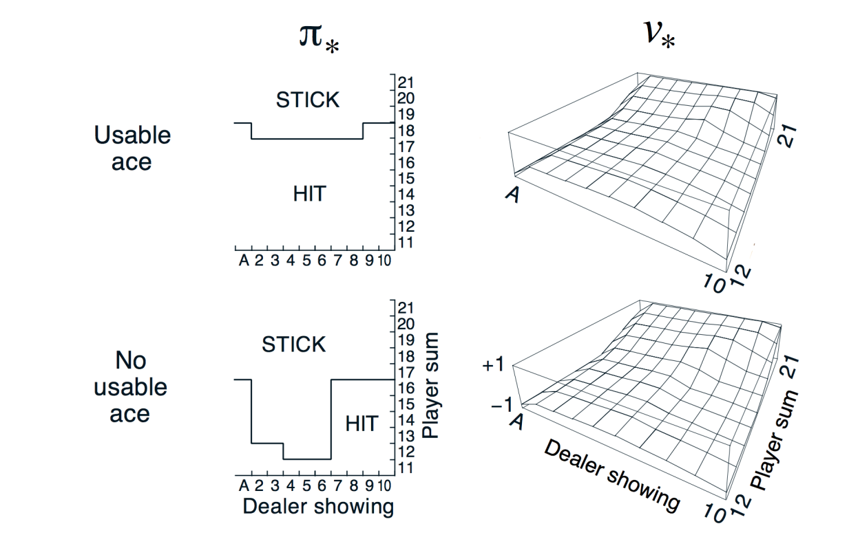
Monte-Carlo Control in Blackjack

Slide 35
Monte-Carlo vs Temporal Difference Control
Monte Carlo Control | Temporal-Difference Control
Updates only after full episodes are finished. | Updates after each step (bootstrapping).
Needs complete episodes of experience. | Can learn from incomplete episodes (online, step-by-step).
Uses the actual return | Uses bootstrapped estimates
High variance | Lower variance

Slide 36
Monte-Carlo vs Temporal Difference Control
Aspect | Monte Carlo (MC) Control | Temporal-Difference (TD) Control
Update Timing | Updates only after full episodes are finished. | Updates after each step (bootstrapping).
Data Requirement | Needs complete episodes of experience. | Can learn from incomplete episodes (online, step-by-step).
Target for Update | Uses the actual return (sum of future rewards). | Uses bootstrapped estimates: Rt+1+γQ(St+1,At+1)R_{t+1} + \gamma Q(S_{t+1}, A_{t+1}) (SARSA) or Rt+1+γmax⁡aQ(St+1,a)R_{t+1} + \gamma \max_a Q(S_{t+1},a) (Q-learning).
Variance | High variance (since it depends on full returns). | Lower variance (due to bootstrapping).
Bias | Unbiased (true returns). | Biased (estimates depend on current Q-values).
Convergence | Converges with GLIE (Greedy in the Limit with Infinite Exploration). | Converges with GLIE for SARSA; Q-learning converges to optimal policy under certain conditions.
On/Off Policy | Typically on-policy (ε-greedy). | SARSA = on-policy; Q-learning = off-policy.
Exploration | Needs GLIE conditions for convergence. | Same: SARSA needs GLIE; Q-learning learns optimal policy while still exploring.
Practicality | Less practical for continuing tasks (needs episodes). | More practical: works in real-time, can be used in ongoing problems.

Slide 37
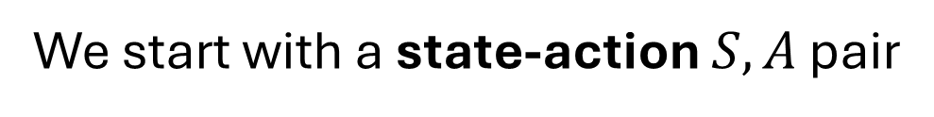

$$S,A$$
We start with a state-action $S,A$ pair

Slide 38


$$S,A$$
$$R$$
Then we sample the environment to observe the reward $R$ we will receive

Slide 39

$$S,A$$
$$R$$
$$S′,A$$
And also observe the next state $S′$ with end up with

Slide 40

$$S,A$$
$$R$$
$$S′,A$$
$$A′$$
And then we sample our own policy at the next state $S’$

Slide 41
$$S,A$$
$$R$$
$$S′,A$$
$$A′$$
New Q – Value Estimation
Current Q – Value Estimation
Learning Rate
Immediate Reward
Value of the next state-action pair
Current Q – Value Estimation

Slide 42
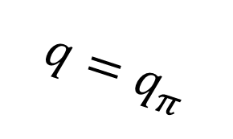




On-Policy Control with Sarsa
$$q=q_{π}$$
Optimal action-value function $q_{∗}$
Initial action-value function $q$
Optimal policy $π_{∗}$
$$π=greedy(q)$$

Slide 43






$$q=q_{π}$$
Optimal action-value function $q_{∗}$
Initial action-value function $q$
Optimal policy $π_{∗}$
$$π=greedy(q)$$
Every time-step:
For Policy evaluation, we use Sarsa
For Policy improvement, we use $ε−$Greedy policy improvement

Slide 44

Sarsa for On-Policy Control

Slide 45


Windy Gridworld Example
0 | 0 | 0 | 1 | 1 | 1 | 2 | 2 | 1 | 0
Actions
Reward= -1 per step
Undiscounted

Slide 46


Sarsa on the Windy Gridworld

Slide 47

Setup
States:
(0,0), (0,1), (0,2), (1,0), (1,1 poison), (1,2 terminal).
Actions:
U, D, L, R (up, down, left, right).
Rewards:
(0,1) cheese = +1 (first visit).
(1,2) big cheese = +3 (terminal).
(1,1) poison = –1 (not visited here).
Step cost = –0.1.
Parameters: α=0.5,γ=1

Slide 48
Episode Path
Step 1: (0,0) →R→ (0,1) [reward +1]
Step 2: (0,1) →R→ (0,2) [reward –0.1]
Step 3:(0,2) →L→ (0,1) [reward –0.1]
Step 4:(0,1) →R→ (0,2) [reward –0.1]
Step 5: (0,2) →D→ (1,2 terminal) [reward +3]

Slide 49

$$Initialize all to 0$$
State | U | D | L | R
(0,0) | 0.0 | 0.0 | 0.0 | 0.0
(0,1) | 0.0 | 0.0 | 0.0 | 0.0
(0,2) | 0.0 | 0.0 | 0.0 | 0.0
(1,0) | 0.0 | 0.0 | 0.0 | 0.0
(1,1) | 0.0 | 0.0 | 0.0 | 0.0
(1,2) | — | — | — | —

Slide 50


$$\text{Step}\text{ 1}$$
$$\text{Target}= 1+Q(0,1,R)=1+0=1$$
$$\text{Q}\text{(0,0,}\text{R}\text{)} \text{=} \text{0} \text{+} \text{0.5} \text{(1} \text{−} \text{0)} \text{=} \text{0.5}$$
State | U | D | L | R
(0,0) | 0.0 | 0.0 | 0.0 | 0.5
(0,1) | 0.0 | 0.0 | 0.0 | 0.0
(0,2) | 0.0 | 0.0 | 0.0 | 0.0
(1,0) | 0.0 | 0.0 | 0.0 | 0.0
(1,1) | 0.0 | 0.0 | 0.0 | 0.0
(1,2) | — | — | — | —

Slide 51


$$\text{Step} \text{2}$$
$$\text{Target}\text{ = −0.1 + 0 = −0.1}$$
$$\text{Q}\text{(0,1,}\text{R}\text{) = 0 + 0.5(−0.1 − 0) = −0.05}$$
State | U | D | L | R
(0,0) | 0.0 | 0.0 | 0.0 | 0.5
(0,1) | 0.0 | 0.0 | 0.0 | -0.05
(0,2) | 0.0 | 0.0 | 0.0 | 0.0
(1,0) | 0.0 | 0.0 | 0.0 | 0.0
(1,1) | 0.0 | 0.0 | 0.0 | 0.0
(1,2) | — | — | — | —

Slide 52

$$\text{Step} \text{3}$$
$$\text{Q}\text{(0,1,}\text{R}\text{)} \text{=} \text{−0.1} \text{+} \text{(−0.05)} \text{=} \text{−0.15}$$
$$\text{Q}\text{(0,2,}\text{L}\text{)} \text{=} \text{0} \text{+} \text{0.5(−0.15} \text{−} \text{0)} \text{=} \text{−0.075}$$
State | U | D | L | R
(0,0) | 0.0 | 0.0 | 0.0 | 0.5
(0,1) | 0.0 | 0.0 | 0.0 | -0.05
(0,2) | 0.0 | 0.0 | -0.075 | 0.0
(1,0) | 0.0 | 0.0 | 0.0 | 0.0
(1,1) | 0.0 | 0.0 | 0.0 | 0.0
(1,2) | — | — | — | —

Slide 53


$$\text{Step} \text{4}$$
Target = −0.1+Q(0,2,D)=−0.1+0=−0.1
$$\text{Q}\text{(0,1,}\text{R}\text{)=} \text{−0.05+0.5(−0.1−(−0.05))}$$
$$\text{Q}\text{(0,1,}\text{R}\text{)}\text{=} \text{−0.05+0.5(−0.05)}$$
$$\text{Q}\text{(0,1,}\text{R}\text{)} \text{=} \text{−0.05−0.025} \text{=} \text{−0.075}$$
State | U | D | L | R
(0,0) | 0.0 | 0.0 | 0.0 | 0.5
(0,1) | 0.0 | 0.0 | 0.0 | -0.075
(0,2) | 0.0 | 0.0 | -0.075 | 0.0
(1,0) | 0.0 | 0.0 | 0.0 | 0.0
(1,1) | 0.0 | 0.0 | 0.0 | 0.0
(1,2) | — | — | — | —

Slide 54

$$\text{Step} \text{5}$$
Q(0,2,D)=0+0.5(3−0)=1.5
State | U | D | L | R
(0,0) | 0.0 | 0.0 | 0.0 | 0.5
(0,1) | 0.0 | 0.0 | 0.0 | -0.075
(0,2) | 0.0 | 1.5 | -0.075 | 0.0
(1,0) | 0.0 | 0.0 | 0.0 | 0.0
(1,1) | 0.0 | 0.0 | 0.0 | 0.0
(1,2) | — | — | — | —

Slide 55


Off-Policy Learning

Slide 56
Real life examples of Off-Policy Learning
Behaviour Policy
Target Policy

Slide 57

Q-Learning

Slide 58

Off-Policy Control with Q-Learning

Slide 59


$$S_{t},A_{t}$$
We start with a state-action $S_{t},A_{t}$ pair

Slide 60

$$S_{t},A_{t}$$
$$R_{t+1}$$
Then we sample the environment to observe the reward $R_{t+1}$we will receive

Slide 61

$$S_{t},A_{t}$$
$$R_{t+1}$$
$$S_{t+1}$$
And also observe the next state${ S}_{t+1}$ with end up with

Slide 62


$$S_{t},A_{t}$$
$$R_{t+1}$$
$$S_{t+1}$$
$$a$$
And then we sample our own policy at the next state $S_{t+1}$

Slide 63


$$S_{t},A_{t}$$
$$R_{t+1}$$
$$S_{t+1}$$
$$a$$

Slide 64

Q-learning algorithm for Off-Policy Control

Slide 65

Q-Learning
INTRODUCTION TO COMPUTING
Course Code: CCINCOM/L
Joseph Marvin R. Imperial
REINFORCEMENT LEARNING
NU College of Computing and Information Technologies
Course Code: CCRNFLRL

Slide 66
Course Code: CCINCOM/L
Joseph Marvin R. Imperial
REINFORCEMENT LEARNING
NU College of Computing and Information Technologies
Course Code: CCRNFLRL

Slide 67

Course Code: CCINCOM/L
Q-Table is just a simple lookup table where we calculate the maximum expected future rewards for action at each state
This table will guide us to the best action at each state.
Joseph Marvin R. Imperial
REINFORCEMENT LEARNING
NU College of Computing and Information Technologies
Course Code: CCRNFLRL

Slide 68
Course Code: CCINCOM/L
The Q-table is initialized. That’s why all values are = 0. This table contains, for each state and action,
the corresponding state-action values.
Joseph Marvin R. Imperial
REINFORCEMENT LEARNING
NU College of Computing and Information Technologies
Course Code: CCRNFLRL

Slide 69
Course Code: CCINCOM/L
For this simple example, the state is only defined by the position of the mouse.
Joseph Marvin R. Imperial
REINFORCEMENT LEARNING
NU College of Computing and Information Technologies
Course Code: CCRNFLRL

Slide 70
Course Code: CCINCOM/L
Therefore, we have 2 x 3 rows in our Q-table, one row for each possible position of the mouse
Joseph Marvin R. Imperial
REINFORCEMENT LEARNING
NU College of Computing and Information Technologies
Course Code: CCRNFLRL

Slide 71
Course Code: CCINCOM/L
Here we see that the state-action value of the initial state and going up is 0:
Joseph Marvin R. Imperial
REINFORCEMENT LEARNING
NU College of Computing and Information Technologies
Course Code: CCRNFLRL

Slide 72

Course Code: CCINCOM/L
So, the Q-function uses a Q-table that has the value of each state-action pair.
Joseph Marvin R. Imperial
NU College of Computing and Information Technologies
Course Code: CCRNFLRL

Slide 73
Course Code: CCINCOM/L
Given a state and action, our Q-function will search inside its Q-table to output the value.
Joseph Marvin R. Imperial
REINFORCEMENT LEARNING
NU College of Computing and Information Technologies
Course Code: CCRNFLRL

Slide 74

Q-Learning
INTRODUCTION TO COMPUTING
Course Code: CCINCOM/L
In the beginning, our Q-table is useless since it gives arbitrary values for each state-action pair (most of the time, we initialize the Q-table to 0).
Joseph Marvin R. Imperial
REINFORCEMENT LEARNING
NU College of Computing and Information Technologies
Course Code: CCRNFLRL

Slide 75
Q-Learning
INTRODUCTION TO COMPUTING
Course Code: CCINCOM/L
As the agent explores the environment and we update the Q-table, it will give us a better and better approximation to the optimal policy.
Joseph Marvin R. Imperial
REINFORCEMENT LEARNING
NU College of Computing and Information Technologies
Course Code: CCRNFLRL

Slide 76
Q-Learning
INTRODUCTION TO COMPUTING
Course Code: CCINCOM/L
We see here that with the training, our Q-table is better since, thanks to it, we can know the value of each state-action pair.
Joseph Marvin R. Imperial
REINFORCEMENT LEARNING
NU College of Computing and Information Technologies
Course Code: CCRNFLRL

Slide 77

Q-Learning
INTRODUCTION TO COMPUTING
Course Code: CCINCOM/L
Joseph Marvin R. Imperial
REINFORCEMENT LEARNING
NU College of Computing and Information Technologies
Course Code: CCRNFLRL

Slide 78

Q-Learning
INTRODUCTION TO COMPUTING
Course Code: CCINCOM/L
Joseph Marvin R. Imperial
REINFORCEMENT LEARNING
NU College of Computing and Information Technologies
Course Code: CCRNFLRL

Slide 79

Step 2: Choose an Action using the epsilon-greedy strategy
INTRODUCTION TO COMPUTING
Course Code: CCINCOM/L
Joseph Marvin R. Imperial
REINFORCEMENT LEARNING
NU College of Computing and Information Technologies
Course Code: CCRNFLRL

Slide 80

Step 2: Choose an Action using the epsilon-greedy strategy
INTRODUCTION TO COMPUTING
Course Code: CCINCOM/L
At the beginning of the training, the probability of doing exploration will be huge since $ɛ$ is very high, so most of the time, we’ll explore.
Joseph Marvin R. Imperial
REINFORCEMENT LEARNING
NU College of Computing and Information Technologies
Course Code: CCRNFLRL

Slide 81
Step 2: Choose an Action using the epsilon-greedy strategy
INTRODUCTION TO COMPUTING
Course Code: CCINCOM/L
But as the training goes on, and consequently our Q-table gets better and better in its estimations.
Joseph Marvin R. Imperial
REINFORCEMENT LEARNING
NU College of Computing and Information Technologies
Course Code: CCRNFLRL

Slide 82
Step 2: Choose an Action using the epsilon-greedy strategy
INTRODUCTION TO COMPUTING
Course Code: CCINCOM/L
We progressively reduce the epsilon value since we will need less and less exploration and more exploitation.
Joseph Marvin R. Imperial
REINFORCEMENT LEARNING
NU College of Computing and Information Technologies
Course Code: CCRNFLRL

Slide 83

Step 3: Perform Action, Get Reward and Next State
INTRODUCTION TO COMPUTING
Course Code: CCINCOM/L
Joseph Marvin R. Imperial
REINFORCEMENT LEARNING
NU College of Computing and Information Technologies
Course Code: CCRNFLRL

Slide 84
Step 4: Update Q-value
INTRODUCTION TO COMPUTING
Course Code: CCINCOM/L
Joseph Marvin R. Imperial
REINFORCEMENT LEARNING
NU College of Computing and Information Technologies
Course Code: CCRNFLRL

Slide 85
Setup
States:
(0,0), (0,1), (0,2), (1,0), (1,1 poison), (1,2 terminal).
Actions:
U, D, L, R (up, down, left, right).
Rewards:
(0,1) cheese = +1 (first visit).
(1,2) big cheese = +3 (terminal).
(1,1) poison = –1 (not visited here).
Step cost = –0.1.
Parameters: α=0.5,γ=1

Slide 86
Episode Path
Step 1: (0,0) →R→ (0,1) [reward +1]
Step 2: (0,1) →R→ (0,2) [reward –0.1]
Step 3:(0,2) →L→ (0,1) [reward –0.1]
Step 4:(0,1) →R→ (0,2) [reward –0.1]
Step 5: (0,2) →D→ (1,2 terminal) [reward +3]

Slide 87
$$Initialize all to 0$$
State | U | D | L | R
(0,0) | 0.0 | 0.0 | 0.0 | 0.0
(0,1) | 0.0 | 0.0 | 0.0 | 0.0
(0,2) | 0.0 | 0.0 | 0.0 | 0.0
(1,0) | 0.0 | 0.0 | 0.0 | 0.0
(1,1) | 0.0 | 0.0 | 0.0 | 0.0
(1,2) | — | — | — | —

Slide 88

$$Step 1$$
$$q\left(0,0,R\right)=0+0.5\left[1+0−0\right]$$
$$q\left(0,0,R\right)=0.5$$
State | U | D | L | R
(0,0) | 0.0 | 0.0 | 0.0 | 0.5
(0,1) | 0.0 | 0.0 | 0.0 | 0.0
(0,2) | 0.0 | 0.0 | 0.0 | 0.0
(1,0) | 0.0 | 0.0 | 0.0 | 0.0
(1,1) | 0.0 | 0.0 | 0.0 | 0.0
(1,2) | — | — | — | —

Slide 89

$$Step 2$$
$$q\left(0,1,R\right)=0+0.5\left[−0.1+0−0\right]$$
$$q(0,1,R)=−0.05$$
State | U | D | L | R
(0,0) | 0.0 | 0.0 | 0.0 | 0.5
(0,1) | 0.0 | 0.0 | 0.0 | –0.05
(0,2) | 0.0 | 0.0 | 0.0 | 0.0
(1,0) | 0.0 | 0.0 | 0.0 | 0.0
(1,1) | 0.0 | 0.0 | 0.0 | 0.0
(1,2) | — | — | — | —

Slide 90

$$Step 3$$
$$q\left(0,2,L\right)=0+0.5\left[−0.1+0−0\right]$$
$$q\left(0,2,L\right)=−0.05$$
State | U | D | L | R
(0,0) | 0.0 | 0.0 | 0.0 | 0.5
(0,1) | 0.0 | 0.0 | 0.0 | –0.05
(0,2) | 0.0 | 0.0 | –0.05 | 0.0
(1,0) | 0.0 | 0.0 | 0.0 | 0.0
(1,1) | 0.0 | 0.0 | 0.0 | 0.0
(1,2) | — | — | — | —

Slide 91

$$\text{Step} \text{4}\text{: }$$
$$\text{q}\text{(}\text{0}\text{,}\text{1}\text{,}\text{R}\text{)=}\text{−}\text{0}\text{.}\text{05}\text{+}\text{0}\text{.}\text{5}\text{[}\text{−}\text{0}\text{.}\text{1}\text{+}\text{0}\text{−}\text{(}\text{−}\text{0}\text{.}\text{05}\text{)]}$$
$$\text{q}\text{(}\text{0}\text{,}\text{1}\text{,}\text{R}\text{) = }\text{−}\text{0}\text{.}\text{05}\text{+}\text{0}\text{.}\text{5}\text{[}\text{−}\text{0}\text{.}\text{05}\text{]}$$
$$\text{q}\text{(}\text{0}\text{,}\text{1}\text{,}\text{R}\text{) = }\text{−}\text{0}\text{.}\text{05}\text{−}\text{0}\text{.}\text{025}$$
$$\text{q}\text{(}\text{0}\text{,}\text{1}\text{,}\text{R}\text{) = }\text{−}\text{0}\text{.}\text{075}$$
State | U | D | L | R
(0,0) | 0.0 | 0.0 | 0.0 | 0.5
(0,1) | 0.0 | 0.0 | 0.0 | –0.075
(0,2) | 0.0 | 0.0 | –0.05 | 0.0
(1,0) | 0.0 | 0.0 | 0.0 | 0.0
(1,1) | 0.0 | 0.0 | 0.0 | 0.0
(1,2) | — | — | — | —

Slide 92

$$Step 5:$$
$$q\left(0,2,D\right)=0+0.5\left[3−0\right]$$
$$q\left(0,2,D\right)=1.5$$
State | U | D | L | R
(0,0) | 0.0 | 0.0 | 0.0 | 0.5
(0,1) | 0.0 | 0.0 | 0.0 | –0.075
(0,2) | 0.0 | 1.5 | –0.05 | 0.0
(1,0) | 0.0 | 0.0 | 0.0 | 0.0
(1,1) | 0.0 | 0.0 | 0.0 | 0.0
(1,2) | — | — | — | —

